Slide 1
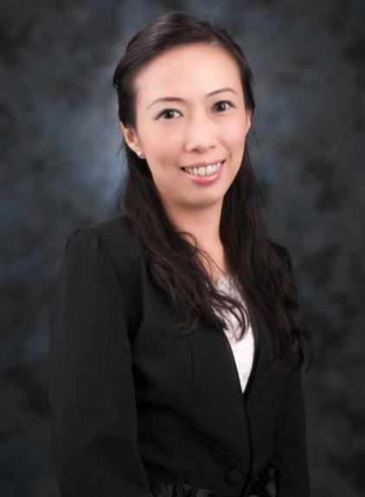
2014美安香港年會
mhk Annual Convention
Veronica Ng
業務拓展及傳訊經理 Sales & Communications Manager

Slide 2
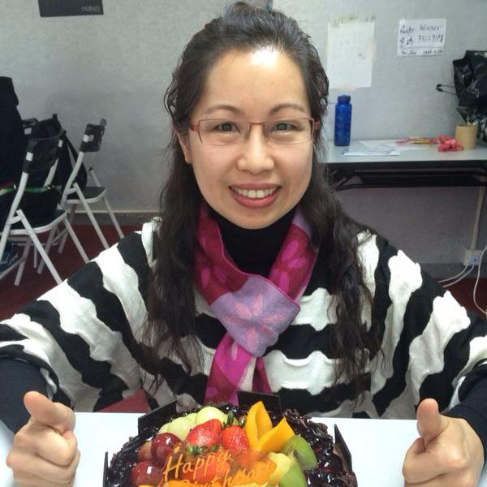
Janet Chiu
Frusanté 活心果茶比賽優勝者

Slide 3
All
總值
HK$3,655
VALUE
你一定要有的3張門票！
it
takes
3
is
“I Got My 3”禮品：
Isotonix® OPC-3®
Frusanté®活心果茶一瓶
美安香港網路中心 mhk WebCenters™

Slide 4
#MHKAC2014

Slide 5
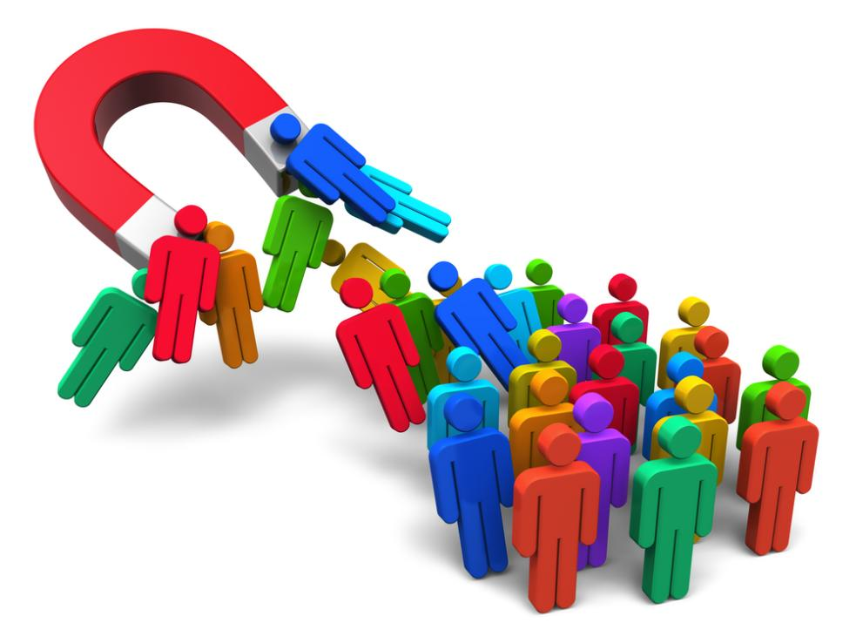
Generating leads
USING SOCIAL MEDIA
社交媒體產生人脈

Slide 7
46%互聯網用戶購物時倚賴
社交媒體
46% of online users rely on social media when making a purchase
社交媒體帶來的生意機會率比平均高13%
Social Media lead conversion rates are 13% higher than the average lead conversation rate
74%營銷商指Facebook是成本效益最高而帶來生意機會的方法
74% of marketers say Facebook is their most cost efficient method for lead generation
93%網絡營銷商使用社交媒體發展事業
93% of network marketers use social media to grow their business
69%社交網站Pinterest的訪客於網上找到決定購買的產品
69% of online visitors of Pinterest found an item they decided to buy online
社交媒體比貿易展、電話營銷、直接郵件或點擊付費廣告帶來的生意機會高近一倍
Social media produces almost double the
marketing leads of trade shows, telemarketing, direct mail, or PPC

Slide 8
Facebook
7億5千萬用戶用7千種不同裝置登入
751 MILLION USERS ACCESS IT USING 7,000 DIFFERENT DEVICES.
代表每5個網頁瀏覽的其中一個
REPRESENTS 1 OUT OF EVERY 5 PAGE VIEWS ON WEB
23%用戶每日登入最少5次
23% USERS LOG IN MORE
THAN 5 X A DAY
1.15
每日有3億5千萬圖片上載量
350 MILLION PHOTOS UPLOADED DAILY
75%的帖在最初的五小時有最大機會產生互動
75% OF POSSIBLE ENGAGEMENT A POST GETS IS IN ITS FIRST 5 HOURS
Billion+
total users
11.5億用戶
最新公佈10億美元的流動銷售額
JUST REPORTED $1 BILLION DOLLARS IN MOBILE SALES

Slide 9
曝光率EXPOSURE
影響力INFLUENCE
品牌注目度
BRAND AWARENESS
約定ENGAGEMENT
產生人脈 LEAD GENERATION
變換CONVERT

Slide 10
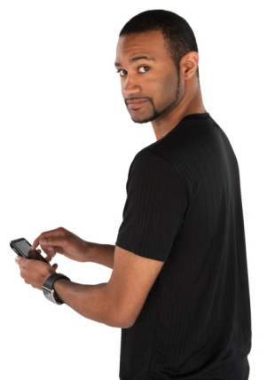
我們活在滾動的世代
We live in a Scroll World….

Slide 11
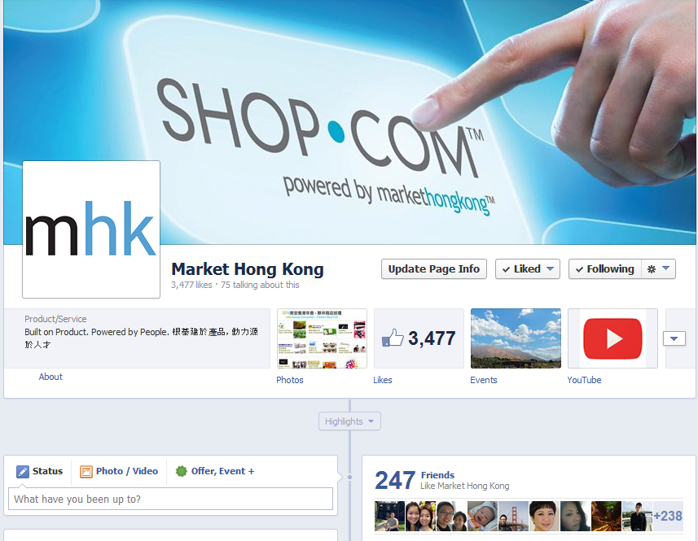

Slide 12
差不多每個帖都應該包含 Almost every post should include a
圖片PHOTO
短片
VIDEO

Slide 13
理想的帖
Perfect Post

Slide 14
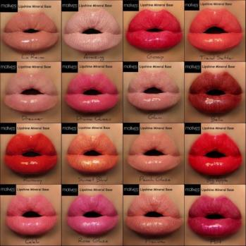
保持正面積極
提供資訊
KEEP THINGS POSITIVE
Positivity breeds engagement and sharing. Inspires and excites users
PROVIDE INFORMATION
The most appealing updates are the ones that offer something but don’t make disclose everything, make fans want to click…
提供連結
PROVIDE A LINK
If you are going to provide a link, you can use Bit.ly so you can track how many people are clicking through from Facebook
STATUS UPDATE
http://link.com
加入圖像
方便流動裝置用戶
INCLUDE IMAGES
Posts with images get the highest amount of engagement on Facebook- so include when you can perfect size 800 x 600
MOBILE FRIENDLY
Use simple imagery that will be easily seen on mobile devices as 70% of your fans will see the posts on their phone
ENGAGE WITH USERS
Posts just don’t grab attention- comments and responses do. Engage with people and build relationships thru conversational dialogue
與用戶交流
時刻關注
BE AVAILABLE
Post when the audience is listening not just when your business is open. This will ensure more engagement from users
LIKE- COMMENT- SHARE
COMMENTS

Slide 15
留言/發帖都應該 保持正面 Comments/posts should be positive
如果你不夠正面
請保持沉默
IF YOU CANNOT
BE POSITIVE
THEN AT LEAST
BE QUIET

Slide 16
在點擊發送之前 Before you hit send..
有沒有校對內容?
發這訊息的目的是什麼? 有趣嗎?
是否應該添加圖片或短片？它的品質高嗎?
是發送這訊息的適當時候嗎?
我的訊息是正面積極而且有意義嗎?
文字內容是否太長?
有包含鼓勵人採取行動的文字嗎? 直接要求對方讚好吧！
Did you proofread your content for grammar and spelling?
What is the intent of this message? Is it interesting?
Should you add a photo or video? Is it high quality?
Is this the appropriate time to send this message?
Is my message positive and offer value?
Is the text too long?
Is the call to action on the post? “LIKE” ask for it!

Slide 17
檢查Hashtag的熱門程度

Slide 18
#MHKAC2014

Slide 19
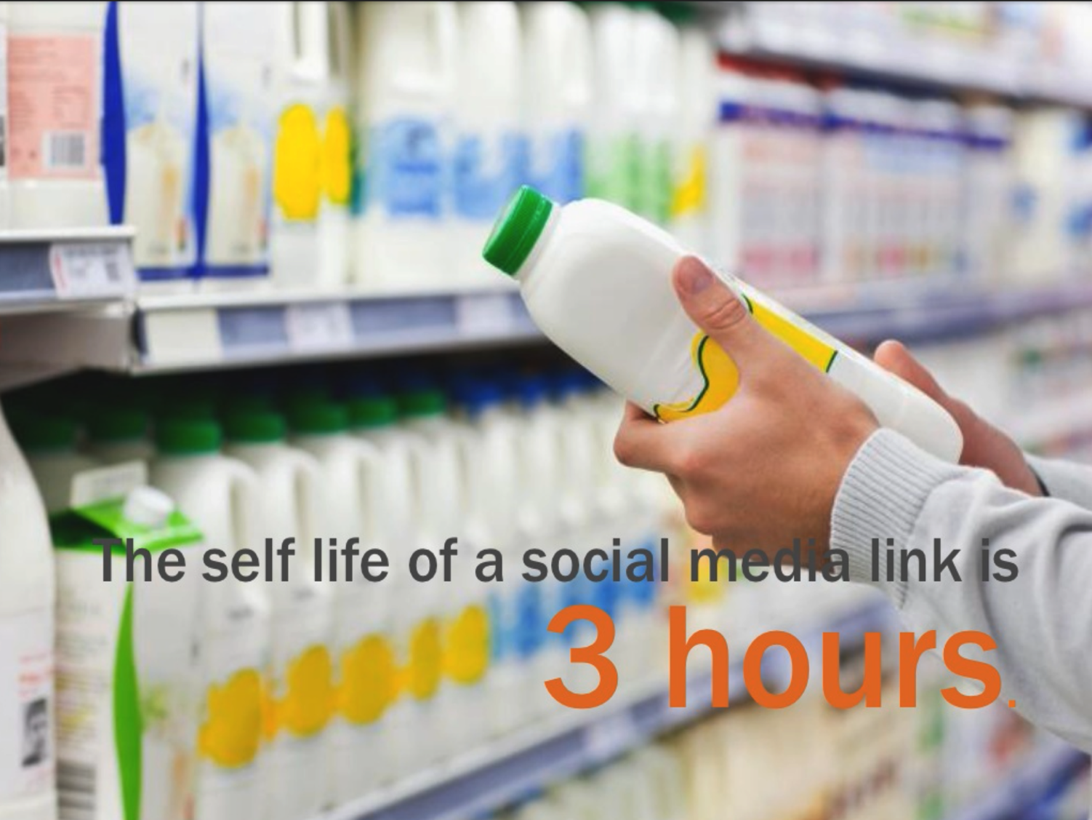
社交媒體連結的期限只有
小時

Slide 20
覆蓋不同時區
重覆分享你的內容

Slide 21
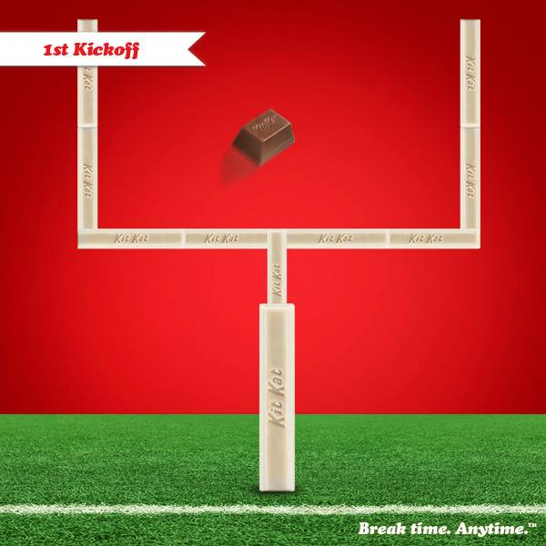
Perfect content, wrong timing
理想的帖，時間不對

Slide 22
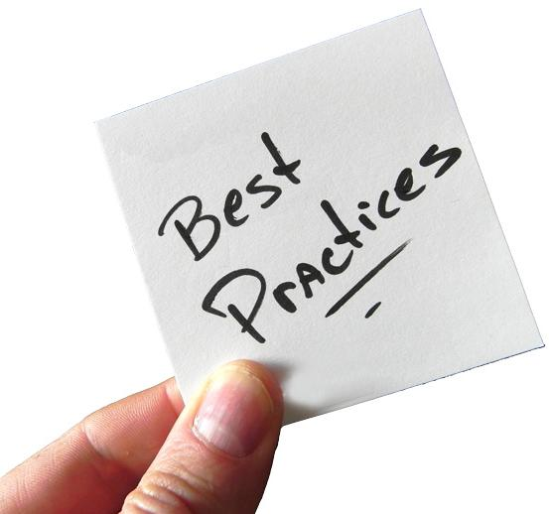
分享。分享照片和你業務的幕後情況。
聆聽。定期留意對你的業務、產品和比賽的留言。
提問。問問你的追隨者，以獲得寶貴的見解，讓他們知道你在聆聽。
回應。回應讚美和回應要及時
你的#hashtag獨特和易記嗎？
Share. Share photos and behind the scenes info about your business.
Listen. Regularly monitor the comments about your business, products and competition.
Ask. Ask questions of your followers to gain valuable insights and show you are listening.
Respond. Respond to compliments and feed back in real time
Is your #hashtag unique and memorable? `

Slide 23
獎勵。貼出特別優惠、折扣和限時的優惠。
展現更廣泛的領導力和技能。有關你業務的前景的參考文章和連結
轉發。公開轉發你的追隨者寫得好的帖，他們一定會更喜歡和尊重你。
正確說話。想一想你的說話在社交媒體上如何被解讀。這是你希望業務在人們心目中出現的形象嗎？
Reward. Tweet/post updates about special offers, discounts, and time-sensitive offers.
Demonstrate wider leadership and know-how. Reference articles and links about the bigger picture as it relates to your business and niche.
Retweet and repost. Retweet and reply publicly to great posts and tweets posted by your followers or fans. They will love and respect you more for it.
Establish the right voice. Think about your voice and how it comes across on social media. Is that how you want your business to appear to the community?`

Slide 24
對業務主要好處 Major Business Benefits
收集資訊、搜尋詳情、學習、問候一下的過程中，找尋並建立新的業務人脈
Finding & creating new business leads by gathering information, finding details, learning about, in regards to….
潛在客戶
競爭對手
同業聯絡
找出“誰認識誰？”
業務關係
成為自己領域公認的專家
Potential clients
Competitors
Industry contacts
Find out “Who knows who?”
Business relationships
Becoming a recognized expert in your field

Slide 25
不要只想著銷售
分享價值和建立
關係

Slide 26
建立親和感 Building Rapport
最多人掙扎的地方
不要發送連結，直至對方詢問或要求
你們的對話應該接近平常一樣
Where most people struggle
No sending links until asked or given the OK
Your conversations should be approached as if offline.

Slide 27
建立親和感 Building Rapport
不要在適當時機前推銷你的業務
不要變得防備批評
一個人在社交媒體的提問方式正是他們現實生活中的表現，因此避開消極的人！
Don’t pitch your business before the opportunity presents itself
Never get defensive
90% of time, the way a person asks on social media is the way they act in real life so avoid negative people!

Slide 28
建立親和感 Building Rapport
不要讓自己出成為專家
多發問，讓對話延續下去
將業務在無意的對話中帶出
內容要提升你的可信度，如短片、網誌、文章
Do make yourself out to be an expert
Do ask a lot of questions to get the conversation going
Do bring up business casually in conversation
Do have content created to make yourself look credible i.e. Videos, Blogs, Articles

Slide 29
初次的訊息 Initial Message
發送私人訊息
看他們的個人資料或其他社交頁面/網誌，找出共同點
告訴他們你發訊息的原因
不要發送任何連結
稱讚他們
不時留言和轉發他們的帖
展示你的關心
Send a personal message
Look at their profile or other social pages/blogs and find common ground
Tell them why you messaging
Do not send any links
Compliment them
Comment and tweet on their posts regularly
Show them you care

Slide 30
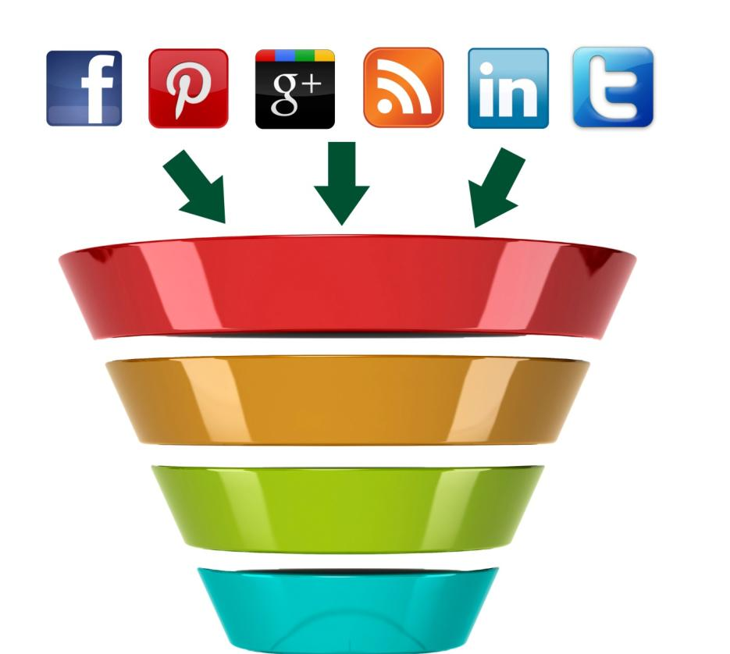
透過社交媒體填滿銷售漏斗
POPULATING THE TOP OF THE SALES FUNNEL THRU SOCIAL MEDIA
網誌/網站
BLOG / WEBSITE
人脈
LEADS
銷售
SALES

